Slide 1
Wild or Feral Children

Slide 2
What if you never had contact with people, only animals?

Slide 3
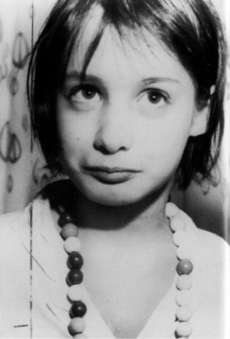
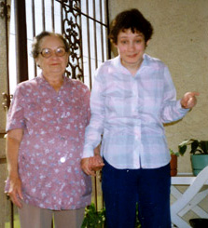
Isolation in Childhood
What if you had no contact with others… you were never socialized.
These children are called FERAL CHILDREN.
Genie- short version
Long version
Studies of feral children are central to the nature vs. nurture debate.
What do you think… which has more effect Nature or nurture????
FYI Genie would be 60 this year, we don’t know if she is alive or not or the condition she is in. She lives in a government institution in LA.
Genie’s brother
Danielle’s story

Slide 4
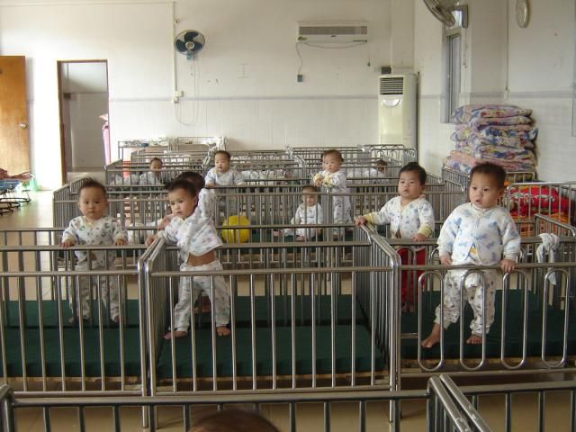
Institutionalized Children
What happens to the development of children in orphanages or hospitals with limited social contact.
They have some of the same characteristics of isolated children.
In a study of orphan babies in an orphanage where they were given basic food and water but were not hugged or loved on by nurses, Within two years 1/3 of the children had “wasted away” and died. Of those that survived, fewer than 25% could walk by themselves, use a spoon, or dress themselves. Only one could form complete sentences.

