Slide 1
Re-socialization
How far is too far?

Slide 2
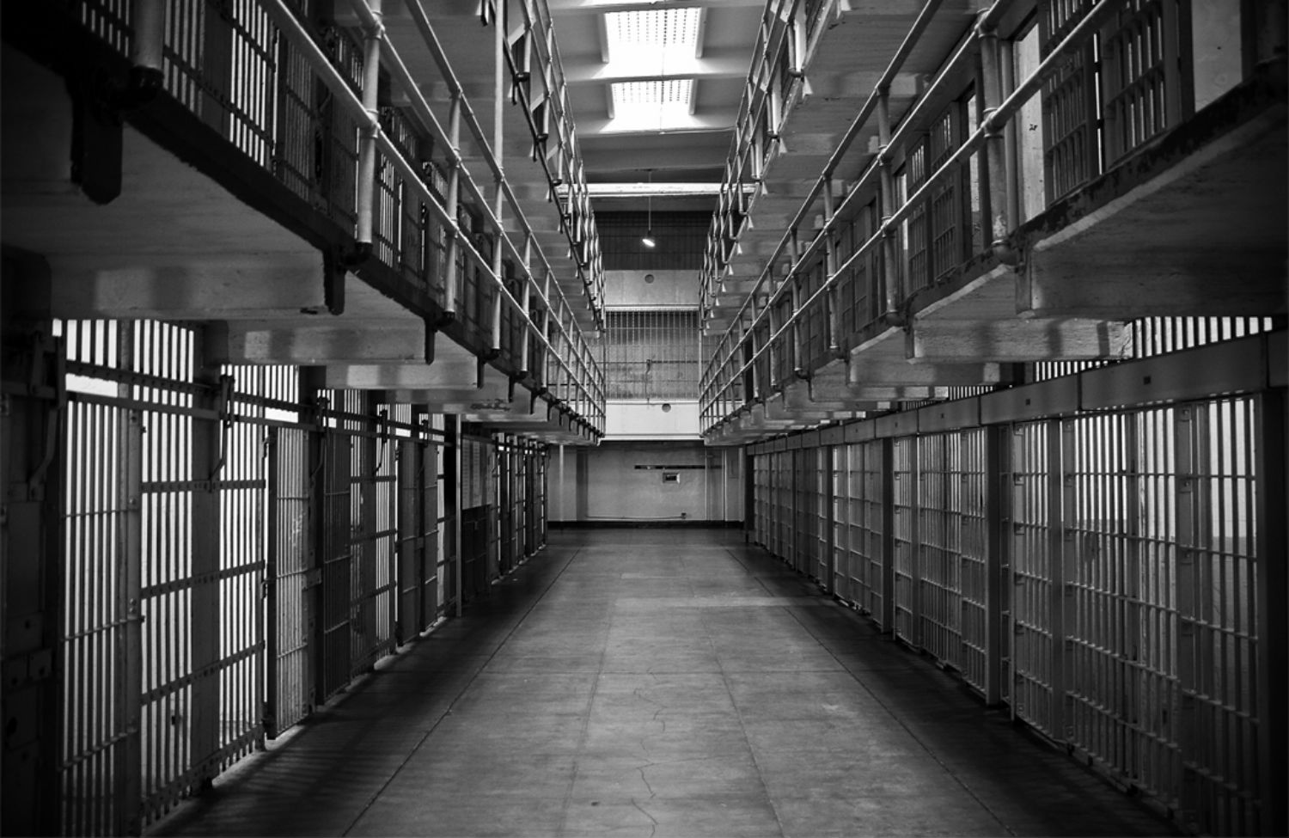
TOTAL INSTITUTION:
Institutions try to RESOCIALIZE their members… try to break them from and of past experiences.
Unique agent…it is a setting in which people are isolated from the rest of society for a set period of time.
Examples: monasteries, boarding schools, prisons, cults and psychiatric hospitals.
Individuals there are not free to manage their own lives, but are controlled and manipulated by those in charge. The end purpose of this control and manipulation is to permanently change the residents.
They try to CHANGE social behavior. How????

Slide 3
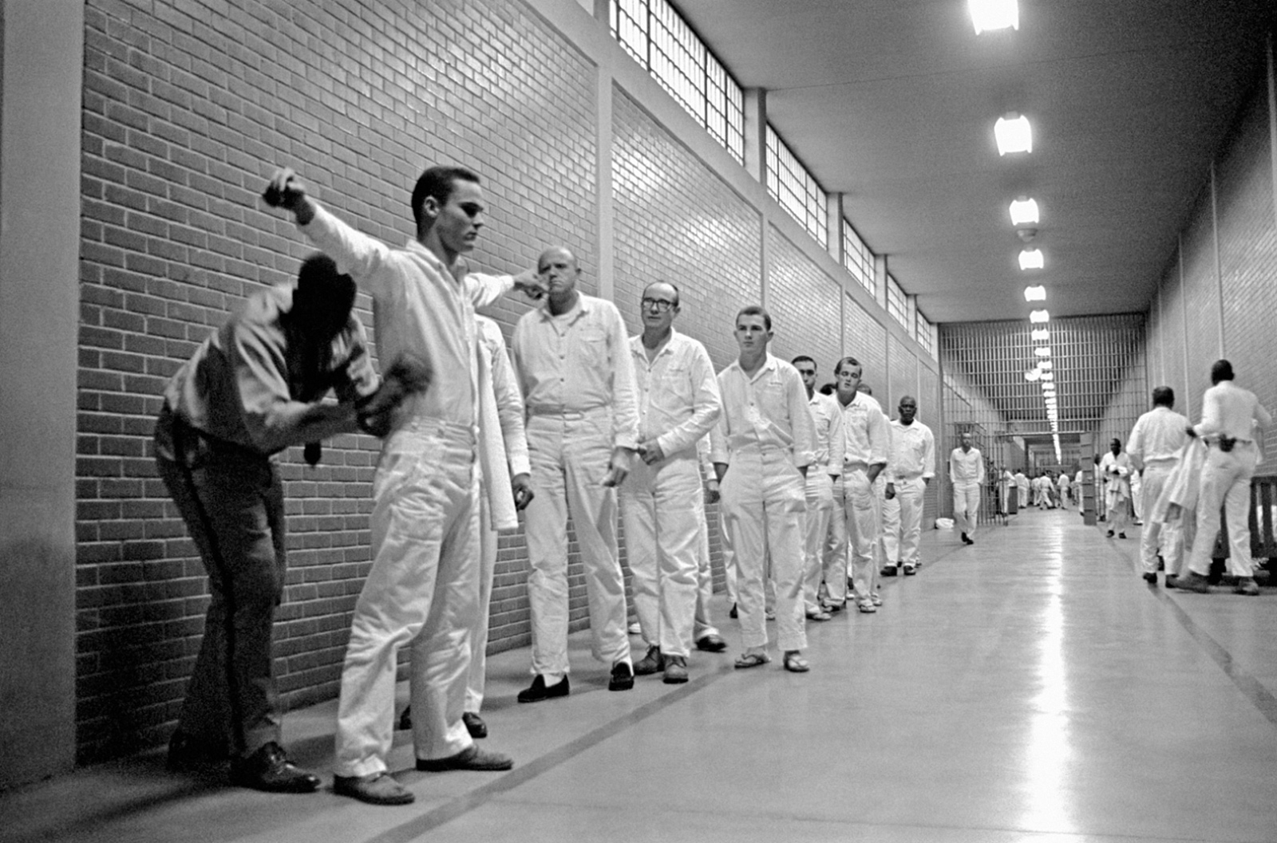
The first step is de-socialization- the process by which people give up old norms, values, attitudes and behaviors. This often means the destruction of old self-concepts of personal identity.
This is often done by replacing personal possessions with standard-issue items- promotes sameness. Use of serial number or new name to identify you as opposed to your past legal name. loss of privacy.
Once the self-concept has been broken down, resocialization- the process in which people adopt new norms, values, attitudes and behaviors- can begin.

Slide 4
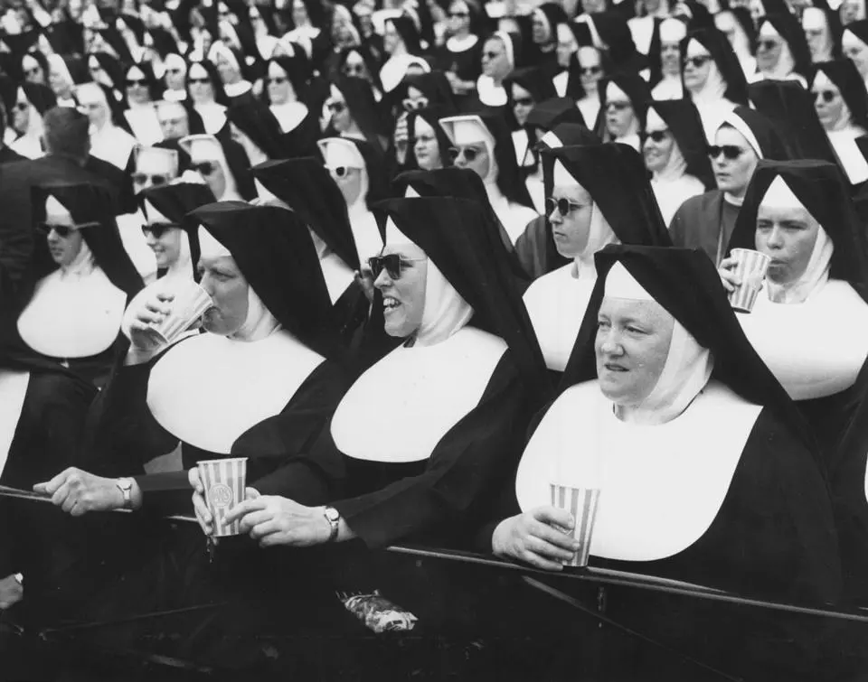
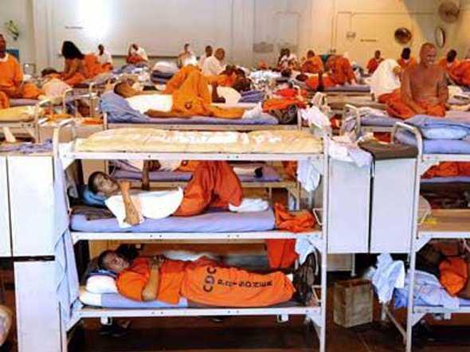

Slide 5
This image lists of U.S. states by adult incarceration and correctional supervision rates according to United States Department of Justice figures in 2013. Incarceration numbers include sentenced and unsentenced inmates in jails and state prisons, but not persons in federal prisons. It does not include youth held in juvenile detention.

Slide 6
Problems with prisons
The U.S has one of the highest rates of imprisonment in the industrialized world- over 4 times that of any Western European country. Justice officials worry that some prisons function as “schools of crime”. If prisons do first desocialize and then resocializae inmates towards a criminal identity, then the U.S. prison system is unintentionally increasing the criminal portion of the population.
Solitary confinement- one of the harshest punishments inmates can receive is being put in solitary. Here they have no interactions with other inmates and minimal interactions with guards. They are confined to 1 room for 22-24 hours a day.
The practice is used when a prisoner is considered dangerous to themselves or to others, is suspected of organizing or being engaged in illegal activities outside or inside of the prison, or, as in the case of a prisoner such as a pedophile or witness, is at a high risk of being harmed by another inmate or inmates.

Slide 7
Video to watch after debate
Last days of solitary

