Slide 1
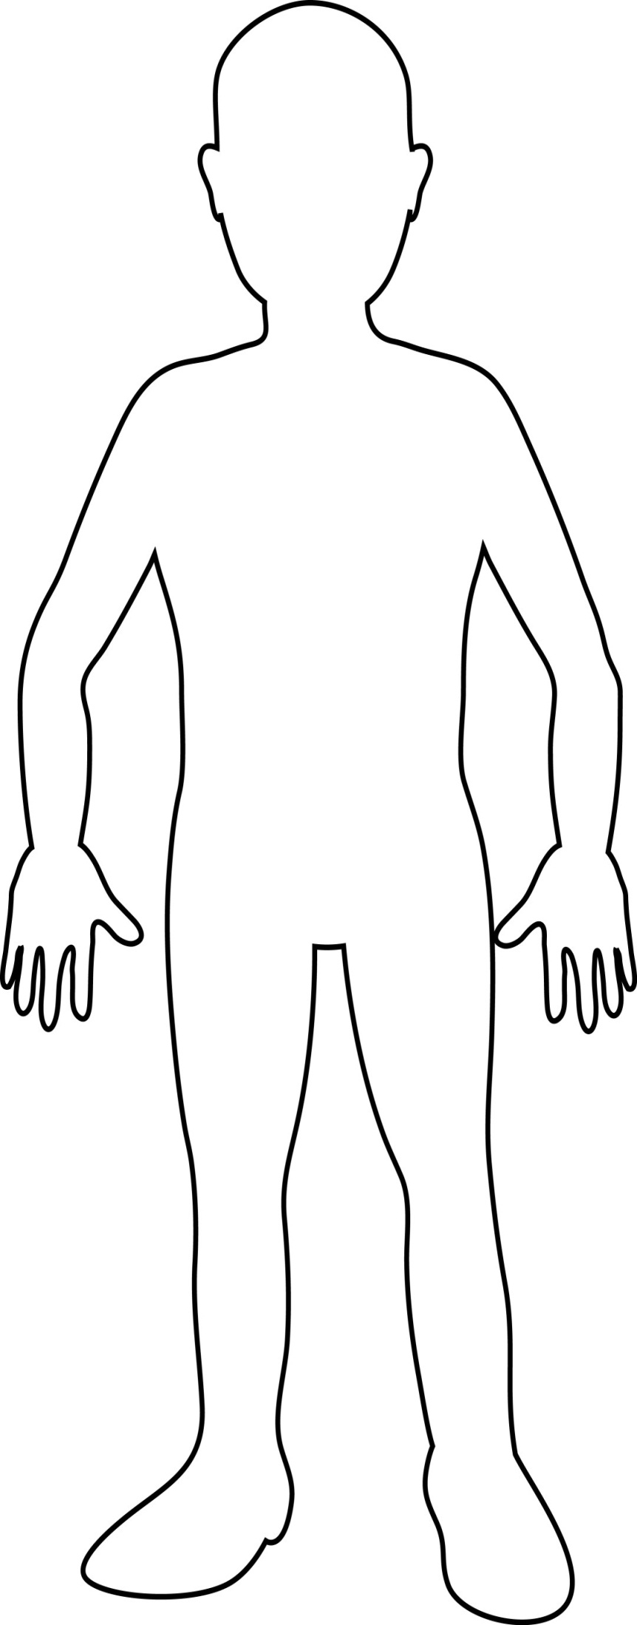
Directions: Label which side is Athens & Sparta, then number the image (1 =religion, 2= Economy, 3= gov 4= art, 5= technology, 6= your choice).

Slide 2
Descriptions For Athens Describe what is it and how your image reflects it.
Religion-____________________________ ______________________________________________________________________
Economy-____________________________ ____________________________________ ____________________________________
Government-_________________________ ____________________________________ ____________________________________
Art-________________________________ ________________________________________________________________________
Technology- _________________________ ___________________________________
Your Choice-_________________________ ________________________________________________________________________

Slide 3
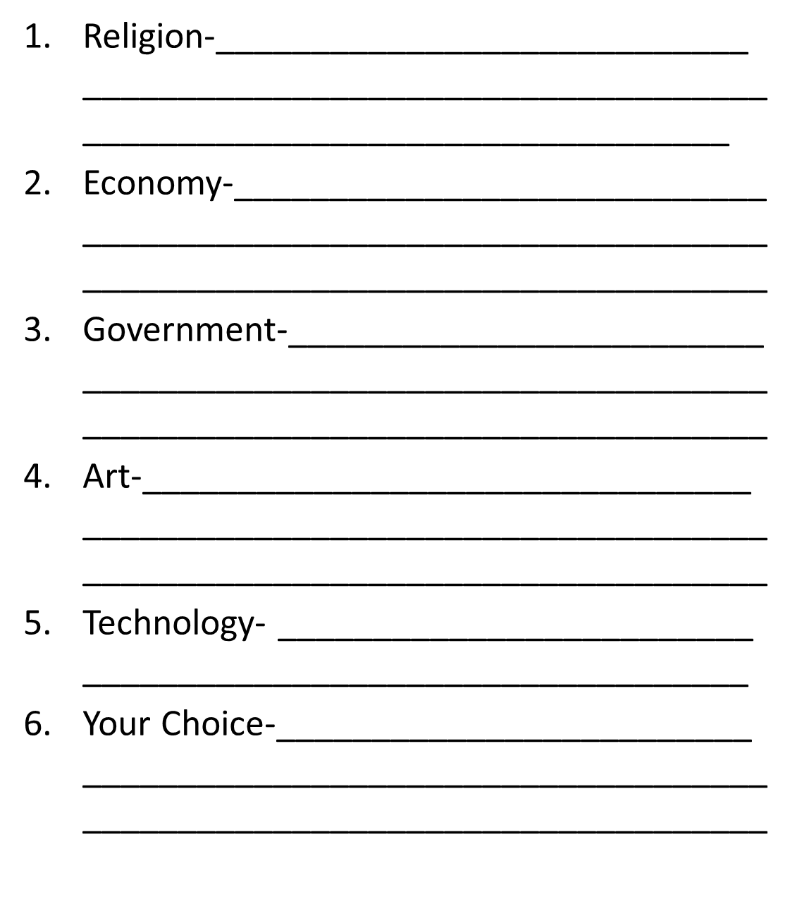
Descriptions for Sparta Describe what is it and how your image reflects it.

