Slide 1
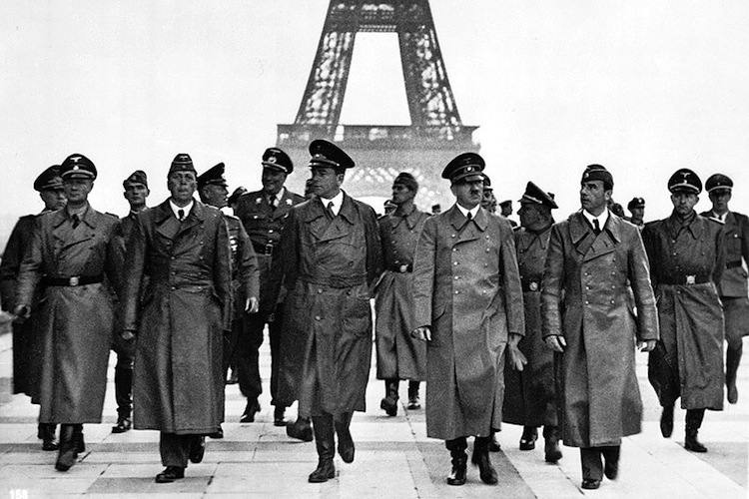
What do I see in this photograph?
What do I think or feel about this photograph?
Ask yourself some questions about this photograph:
If we zoomed out of this photo what do you think we would see?
How do these men look? What type of feelings do they look to be feeling at this moment?
Write a sentence you think one man would be saying to another at this time.
What would be the headline of a German Newspaper, above this image?
What would be the headline of a French Newspaper?

Slide 2
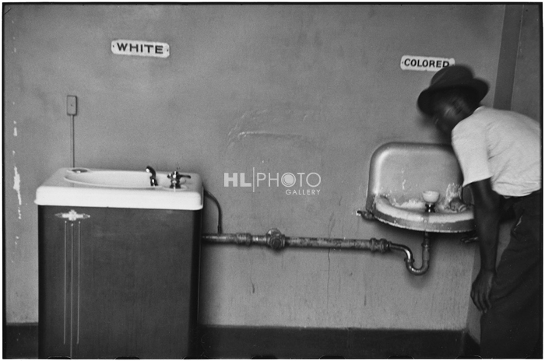
What do I see in this photograph?
What do I think or feel about this photograph?
Ask yourself some questions about this photograph:
Would you still see this today in America?
How is the United States remained the same since this image was taken? How has it changed?
Could you have seen this anywhere else in the world?

Slide 3
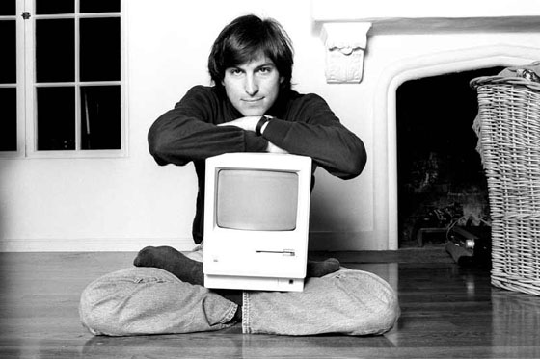
What do I see in this photograph?
What do I think or feel about this photograph?
Ask yourself some questions about this photograph:
Who do you think this is a photograph of?
Why do you believe the photo was shot this way?
What year do you believe it was taken?

Slide 4
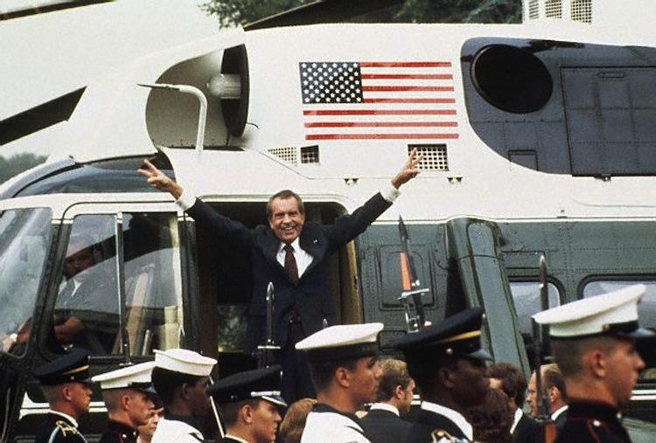
What do I see in this photograph?
What do I think or feel about this photograph?
Ask yourself some questions about this photograph:
How do you think Nixon feels in this photo?
When in his presidency do you believe this photo was taken?
What would Nixon be saying when this photo was taken?

Slide 5
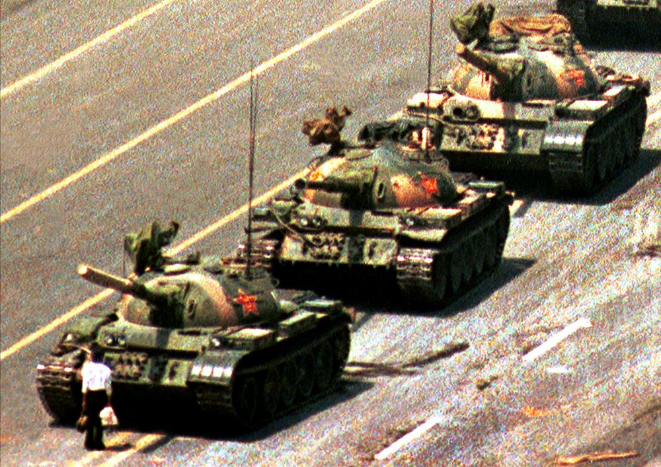
What do I see in this photograph?
What do I think or feel about this photograph?
3. Ask yourself some questions about this photograph:
Where do you think this photo was taken?
What do you believe this man is protesting?
What time period do you think this was?

Slide 6
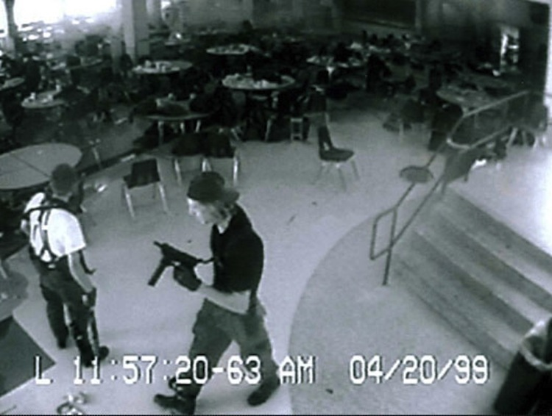
What do I see in this photograph?
What do I think or feel about this photograph?
Ask yourself some questions about this photograph:
What is contradictory or ironic about this photograph?
What do you believe this is a photo of?
How did this event change society forever?

Slide 7
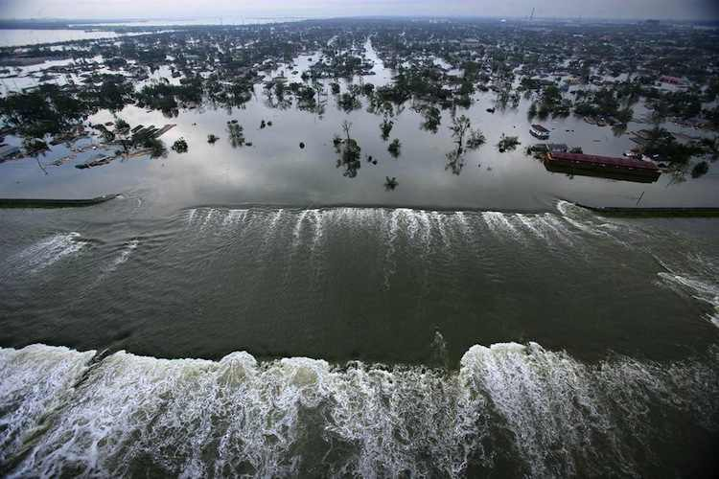
What do I see in this photograph?
What do I think or feel about this photograph?
Ask yourself some questions about this photograph:
What if I told you this photo was not of a beautiful paradise but the effect of a horrific hurricane, would that change the way you feel?
If you zoomed into this photo describe to me what you might see.

