Slide 1
Warm-up
If you could sum-up in one sentence what people were fighting for in the revolutions all throughout the world, what would it be?
When we last left the revolutions in Europe, France had overthrown Napoleon and exiled him for the 2nd time. How should France move on from this? (who should be ruler? What should happen to the territories conquered and controlled by France under Napoleon?)

Slide 2
Congress of Vienna
Chapter 23 Section 5

Slide 3
Restoring the Old order
European heads of government were looking to establish long-lasting peace and stability on the continent after the defeat of Napoleon.
Most of the decisions made in Vienna were made in secret among representatives for the five “great powers”- Russia, Prussia, Austria, Great Britain, and France.

Slide 4
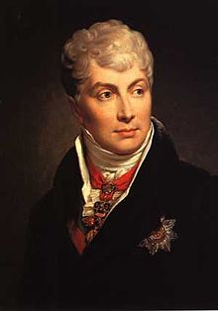
Klemens Von Metternich
By far the most influential of these representatives was the foreign minister of Austria, Klemens Von Metternich.
He felt that Napoleons behavior had been a natural outcome with his experiments with democracy.
He viewed nationalism as a threat to Europeans stability and the survival of the Austrian Empire.

Slide 5
Metternich’s plan
Prevent future French aggression by surrounding France with strong countries. (They will unite smaller countries surrounding France like the 39 German states)
Restore a balance of power, so that no country would be a threat to others (They wanted to weaken France so that it would no longer be able to wage wars of aggression, but they had to be careful not to weaken France so much that they would want to take revenge on anyone).
He wanted to restore Europe’s royal families to the thrones they had held before Napoleon’s conquests. (This is called legitamacy) They believed that the return of the former monarchs would stabilize political relations among the nations.

Slide 6
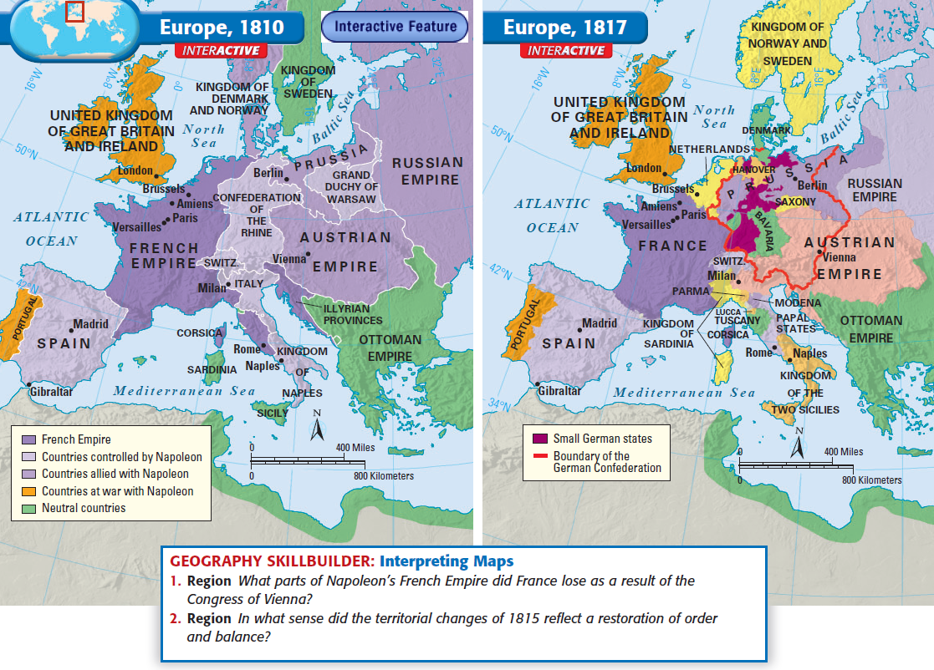

Slide 7
Victory
The congress of Vienna was a political triumph in many ways.
For the first time nations of an entire continent had cooperated to control political affairs (do we still do this today? Can you name some organizations?)
It was one of the most successful peace meetings in history because the settlements they agreed upon were fair enough to not leave any grudges therefore people would not hold hostilities towards each other.
By agreeing to come to one another’s aid in case of threats of peace, the European nations temporarily ensured that there would be a balance of power on the continent (how could this actually lead to more problems in the future?)

Slide 8
United Nations
European Union
NATO
OPEC
NAFTA

Slide 9
New Nationalism
Germany Unified by 1867
Italy Unified by 1870

Slide 10
What do you think it meant by the statement that the French Revolution let the “genie out of the bottle”?
Lego reenactment of The Congress of Vienna

