Slide 1
Bellringer
What did you learn about the process of Industrialization from creating Rhinehartown?
What does the word Urban mean?
Roles of women during this time in history were?
Urban- pertaining to a city; urbanization- city building and the movement of people to cities.
Roles of Women
Maintained the house and worked in the factories
Little education
Paid little for the same work

Slide 2
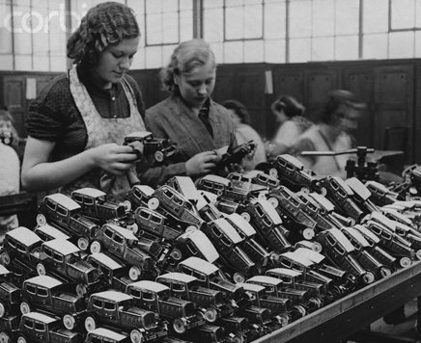
Urbanization Roles of Women

Slide 3
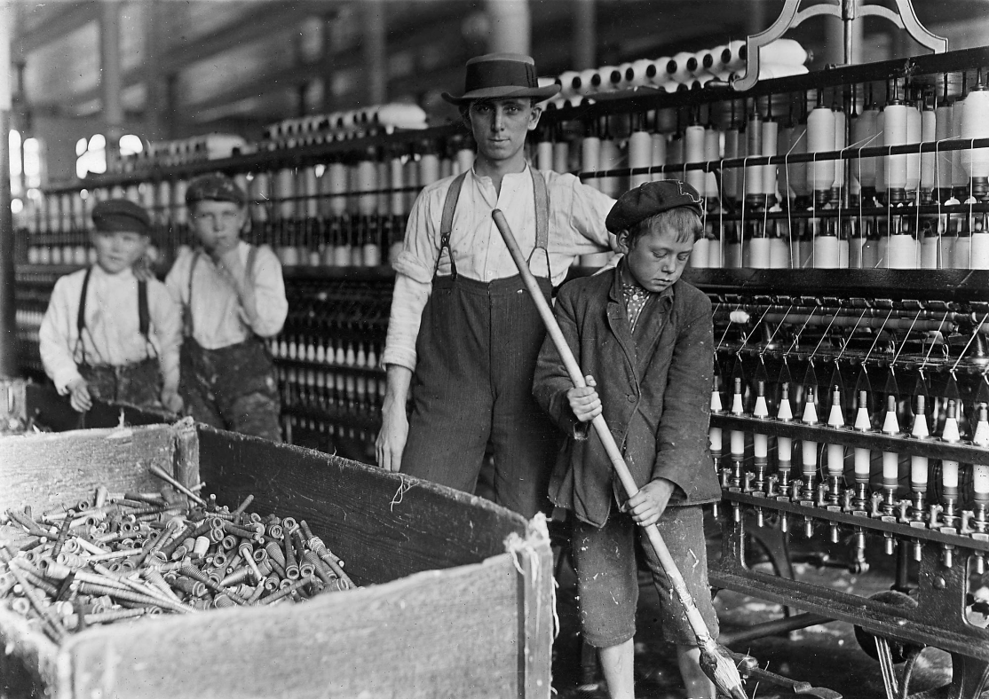
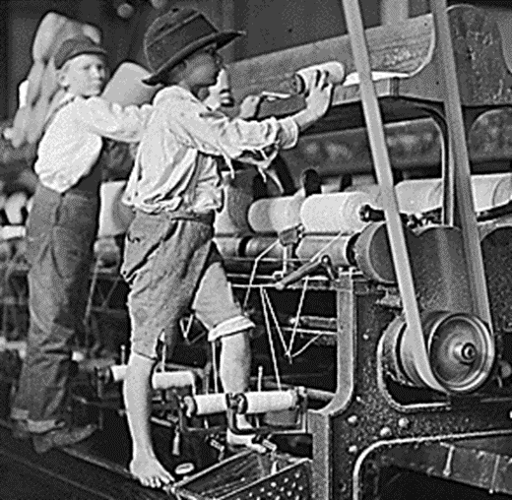
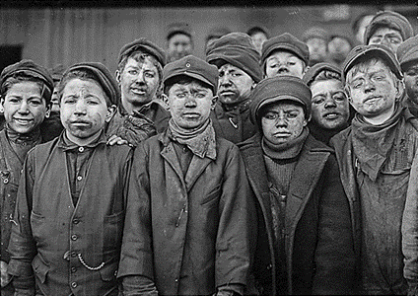

Slide 4
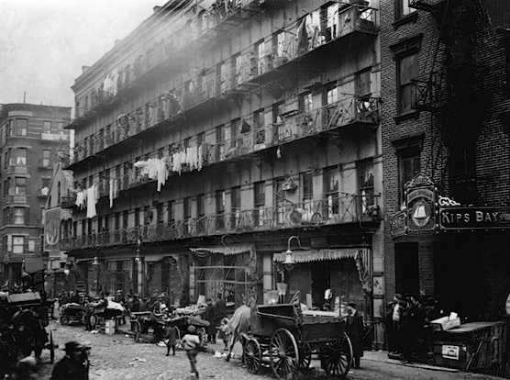
Read the article titled Urbanization
Make a chart comparing the positives and negatives of Urbanization.

Slide 5
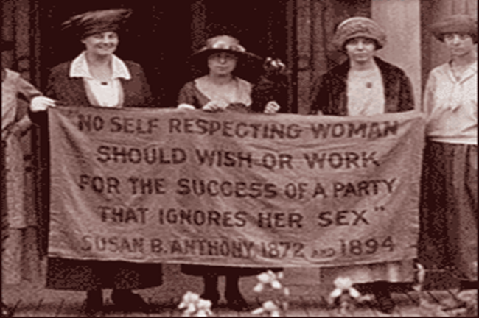
Roles of Women
There was an economic necessity for many women, single and married, to find waged work outside their home.
domestic service, textile factories, and piece workshops.
For some, the Industrial Revolution provided independent wages, mobility and a better standard of living.
For the majority, however, factory work resulted in hardship.

Slide 6
Hannah Goode:
“I work at Mr. Wilson’s mill. I think the youngest child is about 7. I daresay there are 20 under 9 years. It is about half past five by our clock at home when we go in…We come at seven by the mill. We never stop to take our meals, except at dinner. William Crookes is overlooker in our room. He is cross-tempered sometimes. He does not beat me; he beats the little children if they do not do their work right…I have sometimes seen the little children drop asleep or so, but not lately. If they are catched asleep they get the strap. They are always very tired at night…I can read a little; I can’t write. I used to go to school before I went to the mill; I have since I am sixteen.”

Slide 7
Mrs. Smith
“ I have three children working in Wilson’s mill; one 11, one 13, and the other 14. They work regular house there. We don’t complain. If they go to drop the hours, I don’t know what poor people will do. We have hard work to live as it is…My husband is of the same mind about it…last summer my husband was 6 weeks ill; we pledged almost all our things to live; the things are not all out of pawn yet…We complain of nothing but short wages…My children have been in the mill three years. I have no complaint to make of their being beaten…I would rather they were beaten than fired.”

Slide 8
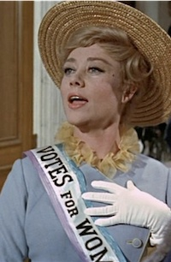
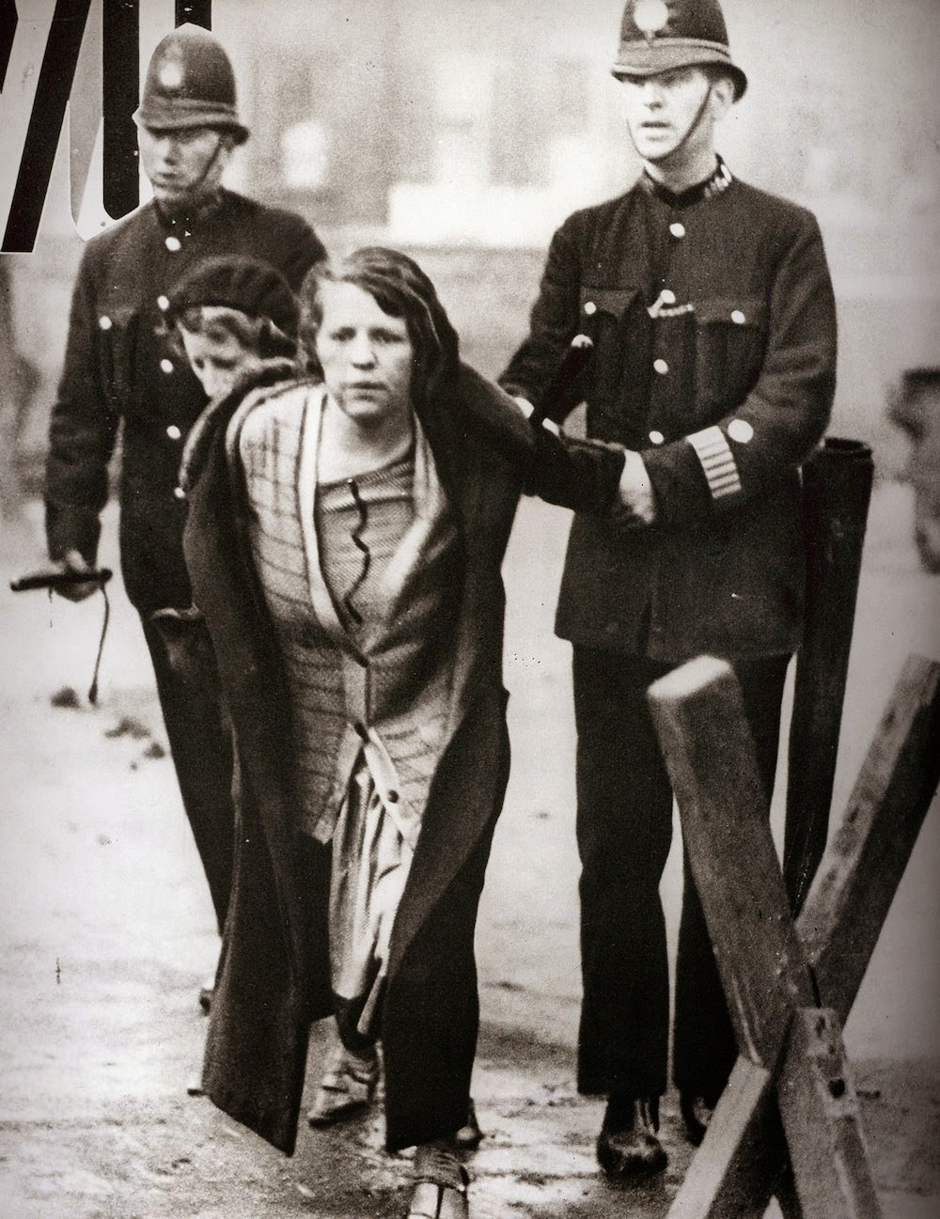
Women’s Suffrage
Suffrage means the right to vote
Suffragettes were women who devoted their lives to making it possible for women to vote.
1918- Parliament passes bill that women over the age of 30 can vote
1920- 19th amendment is added in the US that prohibits anyone from being denied the right to vote based on your sex.
Video
Notes:
Meryl streep plays Emmeline Pankhurst- British political activist and leader of the British suffragette movement

Slide 9
Testimonies from South Wales Mines
Six Yr old girl-
“I have been down six weeks and make 10-14 rakes a day; I carry a full 56 lbs. of coal in a wooden bucket. I work with sister Jesse and mother. It is dark the time we go.
Jane Peacock Watson-
I have wrought in the bowels of the earth 33 years. I have been married 23 years and had nine children, six are alive and three died of typhus a few years since. Have had two dead born. Horse-work ruins the women; it crushes their haunches, bends their ankles and makes the old women at 40.”

Slide 10
Questions
Name some ways this type of work affected family life.
How is this type of work affecting the women’s bodies?
Do women still work in coal mines today?

Slide 11
Effects of Industrialization
Shifted world balance of power. How?
Increased competition in industrialized nations and poverty in less developed nations.
Industrialized countries viewed poor countries as markets for their manufactured products
Industrialization gave Europe tremendous economic power. How?

