Slide 1
Genocide
What do you think about when you see this word?

Slide 2
Genocide
Never again…again and again

Slide 3
How many people does it take…
1.5 million Armenians. 3 million Ukrainians. 6 million Jews. 250,000 Gypsies. 6 million Slavs. 25 million Russians. 25 million Chinese. 1 million Ibos. 1.5 million Bengalis. 200,000 Guatemalans. 1.7 million Cambodians. 500,000 Indonesians. 200,000 East Timorese. 250,000 Burundians. 500,000 Ugandans. 2 million Sudanese. 800,000 Rwandans. 2 million North Koreans. 10,000 Kosovars.
Genocides and other mass murders killed more people in the twentieth century than all the wars combined.

Slide 4
Genocide is the world’s worst intentional human rights problem.

Slide 5
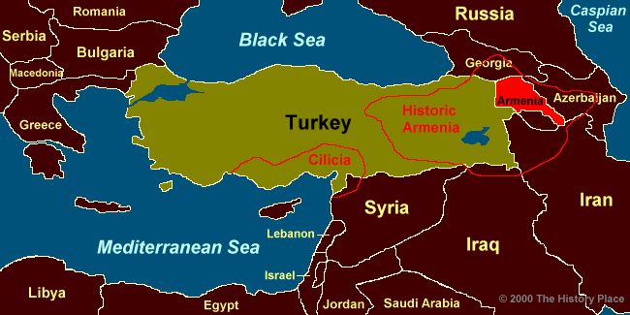
Armenia

Slide 7
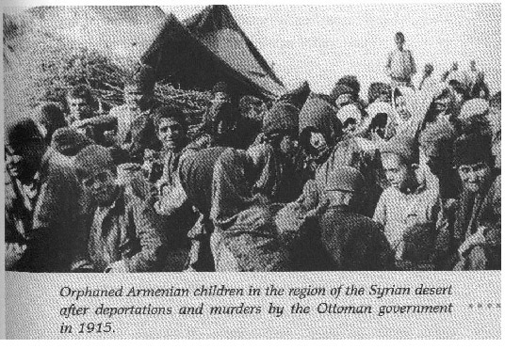

Slide 12
How is it still impacting the people today?
Almost 100 years after the Armenian Genocide, Turkey disputes the term genocide and claims many Turks died during fighting in eastern Turkey in 1915 and 1916.
Genocide article

