Slide 1
Latin American and Haitian Revolutions
Chapter 24 sect 1

Slide 2
New Ideas brewing in Europe

Slide 3
Background
Indigenous peoples and civilizations
Aztec, Mayan, Inca
European Colonization 1500’s
Spain, Portugal, France
French Revolution and Enlightenment 1789
Napoleon’s conquests within Europe 1800’s

Slide 4
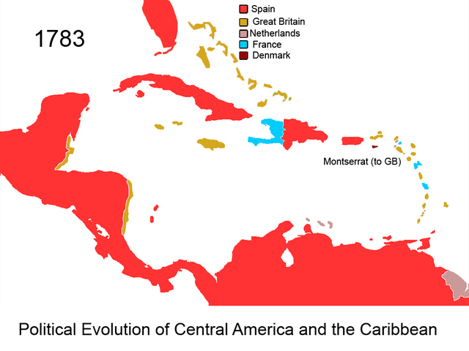
French Colonies: Haiti
Saint Dominique, now known as Haiti
Plantation slavery and sugar colony
First Latin American territory to free itself from European rule.

Slide 5
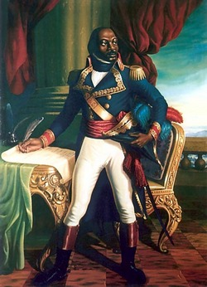
Toussaint Louverture
Became one of the best-known black revolutionaries of all time.
He played a major role in ending slavery in the French colony of Saint-Domingue (now Haiti) and in leading a revolution in which Haiti gained its independence from France.
In 1791, a slave revolt erupted, Toussaint led a black army against the French, helping to force France to abolish slavery in the colony in 1793.
He then helped France by defeating British and Spanish troops that had invaded Saint-Domingue. By April 1796, he ruled the colony with the consent of its French governor.

Slide 6
If Napoleon has his way
France's ruler, Napoleon I, wanted to regain full control of the colony. In 1802, Napoleon sent a large army to reestablish slavery in Saint-Domingue. Toussaint and others resisted and began a revolution to free the colony from French control. Later that year, Toussaint was captured. He was imprisoned in France, where he died on April 7, 1803.

Slide 7
Latin American
Latin America was colonized by several European countries.

Slide 8
Problems: 1. Social Injustice
Creole discontent at being left out of government jobs and trade concessions.
Native discontent at only being able to occupy certain positions in society, being forbidden to grow European crops, or establish factories of a type the Peninsula itself does not possess

Slide 9
Revolution!

Slide 10
Simon Bolivar
The “brains of the revolution”
Spent time in Europe and the newly independent United States
Educated in Europe, he was a fan of Enlightenment Ideas.
He will liberate the Northern countries of Venezuela, Colombia, Panama, Ecuador, Peru and Bolivia from Spanish Rule.

Slide 11
Jose de San Martin
Liberates countries in the south
Bolivar meeting
San Martin

Slide 12
Effects of the Revolutions
Short-term
Long-term
Haiti and Latin America lead successful revolts
Colonial rule ends in much of Latin America
Wars disrupt trade-leads to poverty
Numerous Independent nations in Latin America
Continuing efforts to achieve stable democratic governments and to gain economic independence

Slide 13
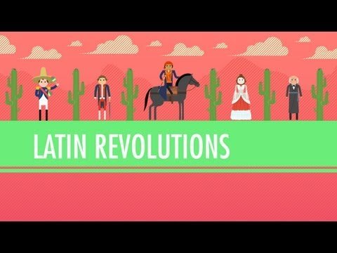
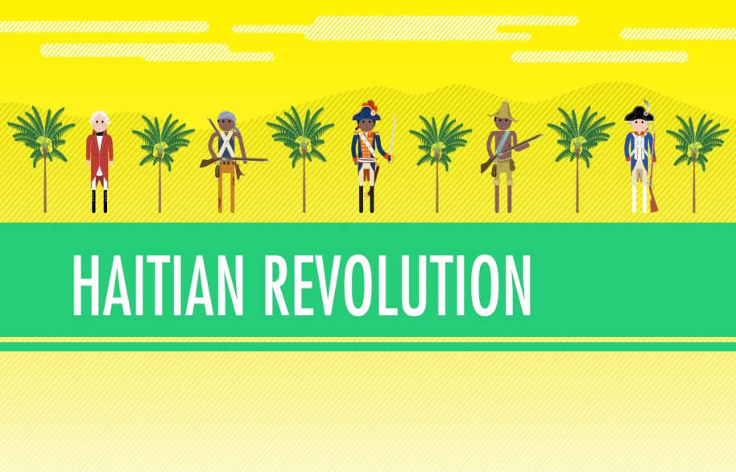
Review videos
Latin American Revolution
Haitian Revolution

