Slide 1
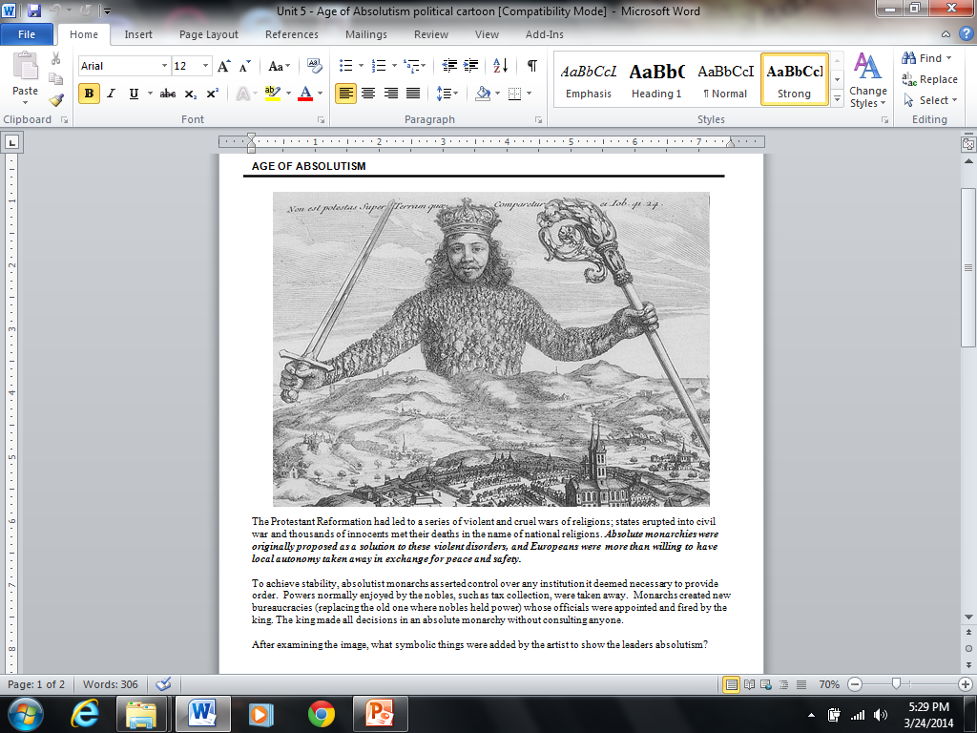

Slide 2
Challenge
Define Absolutism
What is Divine Right?
List examples of Absolute policies implemented by Louis XIV, Peter the Great, Tokugawa, Kangxi
Define Heliocentric and Geocentric
  Sun is the center of the universe (Heliocentric)
  Earth is the center of the universe (Geocentric)
What is a revolution?
  An overthrow or replacement of an established government or political system by the people

Slide 3
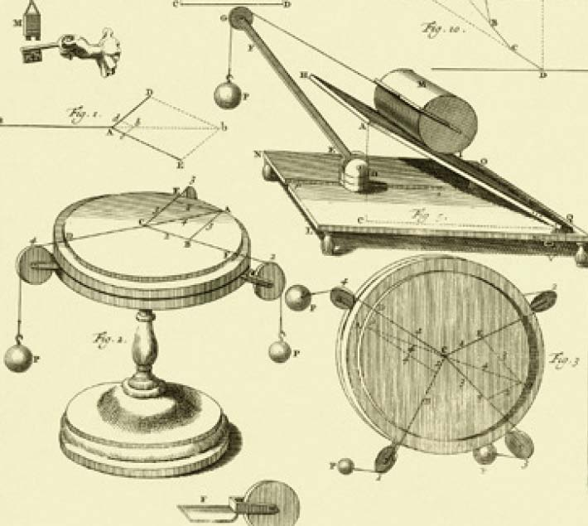
Age of Enlightenment
Age of Reason

Slide 4
Scientific Revolution Changes World View
Renaissance
  A rebirth of learning and the arts
  Inspired curiosity in many fields
  Scholars began to question ideas that had been “accepted” for hundreds of yrs
  Video
Notes:
Renaissance renewed interest in philosophy of the Greco-Roman days
Renaissance also increased interest in math
Art and its desire to reproduce reality led to an increase in science knowledge

Slide 5
Causes of the Scientific Revolution
Renaissance inspired new curiosities
Exploration (broaden European horizons)
Science challenges old ways of thought
Printing press
Work of Scientists (i.e. astronomers, Newton, advancements in medicine)

Slide 6
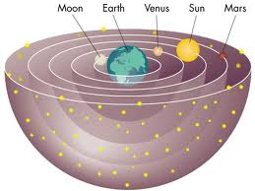
Middle Ages view
Most scholars believed that the earth was in immovable object located at the center of the universe-Geocentric theory
Common sense seemed to support this view
Religion also supported this theory

Slide 7
And a revolution begins
The Scientific Revolution was a new way of thinking about the natural world.
That way was based upon careful observation and a willingness to question accepted beliefs
Traveling the world opened up Europeans to this idea that there was a whole world of new truths to be found.

Slide 8
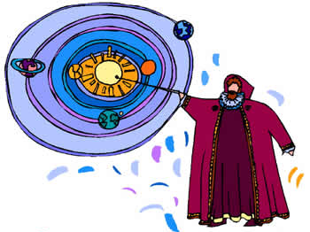
Notes:
Published posthumously

Slide 9
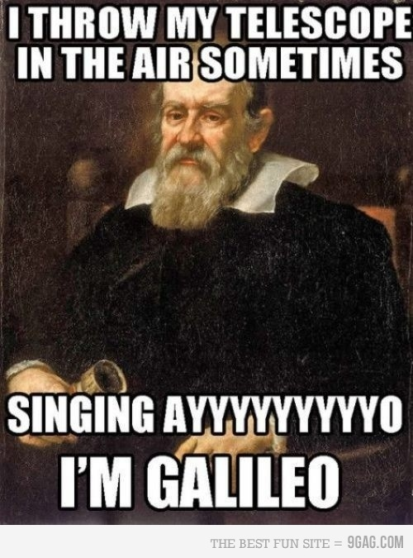
Notes:
Mathematician, astronomer, physicist
Pendulum took same time to make a long swing as it did to make a short one
Built telescope to study moon and planets
Dialogue between– Copernicus and Ptolemy
Pope Urban VIII

Slide 10
Galileo vs. the Church
Video
Result: Galileo had to lie to the church and claim he did not support Copernicus's ideas and he was put on house arrest until he died.
The church did not “apologize” or admit they were wrong until 1992!

Slide 11

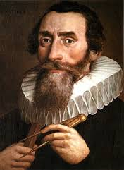
Kepler (1571-1630)
German Astronomer
Discovered that the path of the planets was elliptical rather then circular
The speed of the revolution varied as a function of their distance from the sun.
He made it possible for astronomers to predict mathematically the positions of the earth, sun and planets

Slide 12
“If I have seen further, it is because I have stood on the shoulders of giants.”
-Isaac Newton

Slide 13

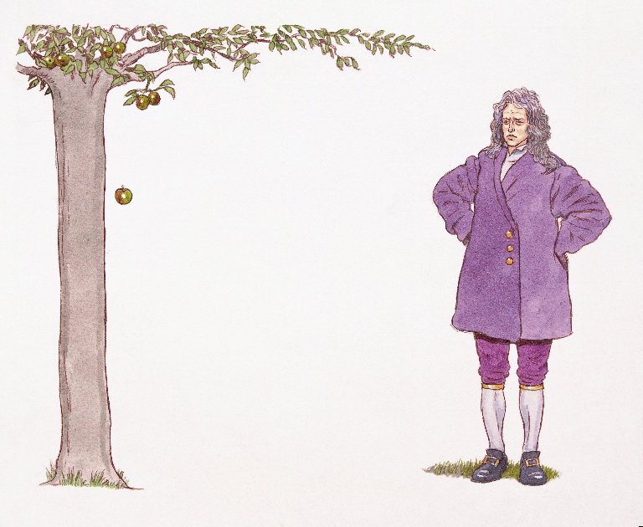
Isaac Newton
1643-1727
Calculus
Three laws of planetary motion-gravity
Proved universe worked in certain laws
  Shouldn’t man?
  Government?
  Education?
Scientific Method
  Observation
  Experimentation
  conclusions
Notes:
Use of scientific method—observation, experimentation, conclusions

Slide 14
Think and Ponder….
Would you have the courage and conviction, to face persecution, in the pursuit of truth?

Slide 15
Review
How did King Louis XIV show that he had absolute rule?
What does it mean to be an absolute ruler?
Peter the Great was greatly influenced by what other part of the world?
Who proved the geocentric theory was wrong?
What did Galileo do?
What was Isaac Newton’s contribution to science?
Review video

Slide 16
Warm-up
Which quote most likely was made by an absolute monarch?
  “the government that governs best govern least”
  “the government must be based on a sound constitution”
  “it is the parliament that must make laws”
  “I am the state”
Who did this; Lowered taxes for peasants, considered by subjects to be a conscientious and fair ruler, created a secret service that reported to him through Palace Memorials
What are some freedoms you receive in America that aren’t freedoms in every country?
Why do you believe you receive the freedoms you mentioned above?

Slide 17
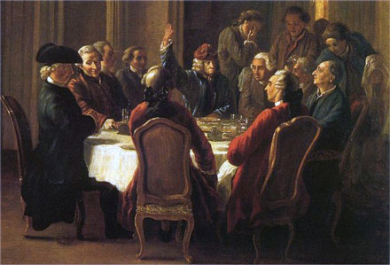
Age of Enlightenment
Enlightenment- a new intellectual movement that stressed reason, thought and the power of individuals to solve problems
Philosophes—enlightened thinkers that dedicated themselves to exposing social problems and fixing them
  Began to reevaluate old notions about other aspects of society
  Attacked superstition, ignorance and easy acceptance of authority
  They attacked Christianity for its rejection of science, otherworldliness, and belief in man's demise
  Crash course
Notes:
Attacked superstition, ignorance, and easy acceptance of authority
Used scientific method

Slide 18
Philosophes Key Ideas
Reason— reason was the absence of intolerance, bigotry and superstition. Reason meant informed thinking about social problems
Nature and natural laws— believed natural laws regulate both the universe and human society
Happiness- seek well-being here and now not in the hereafter; this was an inalienable right
Progress- the discovery of laws of economics and government would improve society and make progress
Liberty- they lived in societies that placed restrictions on speech, religion, and trade. They wanted to remove these limitations on human liberty.
Toleration- The philosophes advocated full religious toleration
Notes:
Scientific revolution demolished old ideas. People looked at world in scientific way and everything was controlled by natural laws

Slide 19
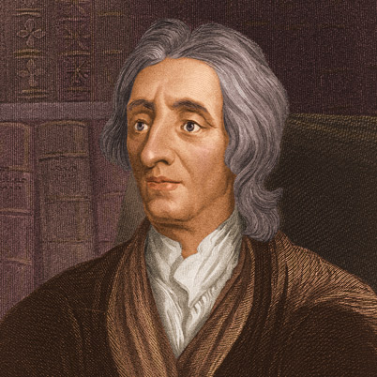
John Locke
Locke rejected the ideas that humans are innately
brutish. People are instead the products of their training,
education and experience.
Human had a natural ability to govern their own affairs and to look after the welfare of society
  Favored the idea of self-government
All people are born with 3 natural rights
  Life
  Liberty
  Property
  These rights are derieved from what Locke called the “law of nature”. Government is a contract in which the rulers promise to safeguard the people’s natural rights. If rulers betray their trust, the governed have the right to replace them.

Slide 20
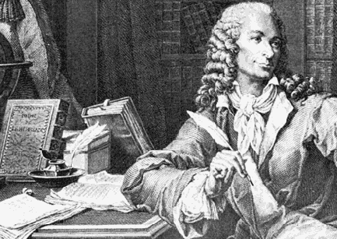
Voltaire (Pen name)
Probably the most brilliant and influential of the philosophes
He criticized France’s rigid government and denounced religious intolerance.
Although he made lots of enemies he never stopped fighting for tolerance, reason, freedom of religious belief and freedom of speech (hm…sound familiar?)
“ I Do not agree with a word you say but will defend to the death your right to say it”

Slide 21
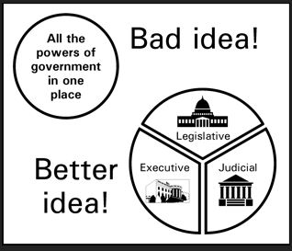
Baron de Montesquieu
He was a French nobleman and attorney who wanted to limit the abuses of royal absolutism.
Believed Britain was the best-governed and most politically balanced country of his own day
Believed in a separation of powers- division of power among several branches of government (again something sounds familiar about this…)
The idea behind this is no one group possess too much power and control
Going to become the basis for the
US Constitution

Slide 22
Rousseau
Passionately committed to individual freedom
He believed the sovereign power in a state does not lie in a ruler. Instead it resides in the general will of the community as whole.
Rulers are seen as servants to the community. If they fail to carry out the people’s will, they should be removed.
The Social Contract is a book written by Rousseau, is one of the most influential books on political theory in European history. It stated that people CHOSE to give up some of their freedom in order for the common good of society.

Slide 23

Legacy of the Enlightenment
It examined such principles as
  Divine right of monarchs
  The union of church and state
  The existence of unequal social classes
Produced three long-term effects that helped shape western ideas
  Belief in progress
  A more secular outlook
  Importance of the individual

Slide 24
Belief in Progress
Galileo and Newton opened the doors in science to new discoveries
Scientists made key new discoveries in chemistry, physics, biology and mechanics
Success in the Scientific Revolution gave people confidence that human reason can solve social problems
Philosophes and reformers urged an end to the practice of slavery and argued for greater social equality, as well as a more democratic style of government.

Slide 25
More secular outlook
Remember secular means “worldly” or “non-religious”
People began to question openly their religious beliefs and the teachings of the church
Newton is going to discover that some “mysteries of God” could be explained mathematically and Voltaire is going to attack the practice of organized Christianity
They wanted to promote tolerance of all religions

Slide 26
Importance of the individual
As people began to turn away from the church and royalty for guidance, they looked to themselves instead.
Government, they argued, was formed by individuals to promote their welfare.

Slide 27
Bellringer
How does Locke’s view of human nature differ from that of Hobbes?
In your own words define the Enlightenment
List the different Enlightenment thinkers
Rousseau’s Social Contract vs. Hobbes

Slide 28
“Man is born free, and everywhere he is in chains” - Rousseau

Slide 29
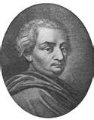
Beccaria
governments should seek the greatest good for the greatest number of people.
An Italian Philosophe
He believed that laws existed to preserve social order, not to avenge crimes
Believed that the degree of punishment should be based on the seriousness of the crime

Slide 30
Women and the Enlightenment
Philosophes took a traditional view towards women
Rousseau viewed that girl’s education should mainly teach them how to be a good wife and mother
Other critics scolded women for reading novels- they thought it encouraged idleness and wickedness
English writer Mary Astell addressed the lack of educational opportunities for women.
She later writes about the unequal relationship b/n men and women in marriages

Slide 31
“ If all men are born free, how is it that all women are born slaves?”

Slide 32
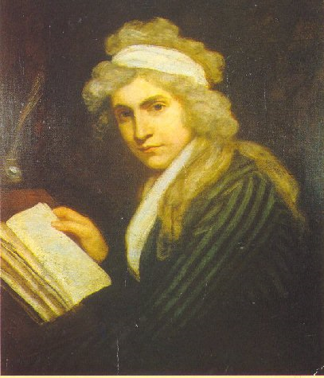
Mary Wollstonecraft
One of the most persuasive women writers of the time
Writes A Vindication of the Rights of Woman
Argued with Rousseau’s thoughts on women’s education. She believed that women, like men, needed education to become virtuous and useful
She also urges women to enter into the male dominated fields of medicine and politics

Slide 33
Women and the Enlightenment II
Helped spread Enlightenment ideas at social gatherings called salons
Emilie du Châtelet was an aristocrat trained as a mathematician and physicist. By translating Newton’s work from Latin into French, she helped stimulate interest in science in France.

Slide 34
Review!!
For each term or name, write a sentence explaining its significance.
  Enlightenment • social contract • John Locke • philosophe • Voltaire • Montesquieu • Rousseau
What are the natural rights with which people are born, according to John Locke?
Who were the philosophes and what did they advocate?
What was the legacy of the Enlightenment?
DRAWING CONCLUSIONS-Do you think the philosophes were optimistic about the future of humankind? Explain.

Slide 35
The enlightenment Spreads
Ideas spread with the help of books, magazines, and word of mouth
Influenced everything from the artistic world to governments
Paris is going to be the cultural and intellectual capital of the Europe
Wealthy women held regular social gatherings in their drawing rooms. These social gatherings were referred to as salons.

Slide 36
Encyclopedia
The most influential of the salon hostesses in Voltaire’s time was Marie-Thérèse Geoffrin.
She helped finance the project of a leading philosophe named Denis Diderot.
He created a large set of books to which many leading scholars of Europe contributed articles and essays. He called it Encyclopedia and began publishing the first volumes in 1751.
Do you think their was any controversy around this new scholarly work?

Slide 37
Angered both the French Government and Catholic Church
They said it undermined church authority, encouraged a spirit of revolt, and fostered “moral corruption, irreligion and an unbelief”.

