Slide 1
Warm-up
What qualities must a civilization possess? (Think GREAT)
What was the first written language called?
What is something bad that you have done, and what was the punishment that you received for it.
4. Did you feel like the punishment was fair for the “crime” you committed?
5. Fill in this quote:
“ The first duty of government is to protect the ____________ from the ___________________.” – Hammurabi

Slide 2
Government in Mesopotamia

Slide 3
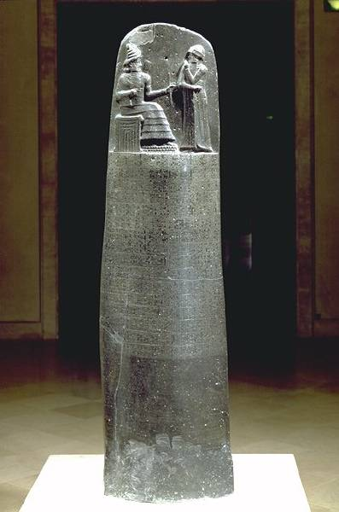
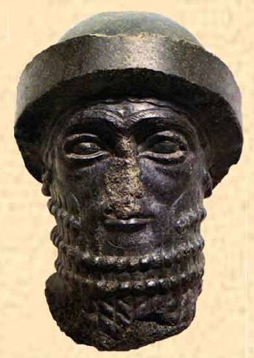
Hammurabi’s [r. 1792-1750 B. C. E.] Code

Slide 4
Ham’s Code
Cause: Hammurabi recognized that a single, uniform code of laws would help to unify the diverse groups within his empire.
Effect: He collected existing rules, judgments, and laws into the Code of Hammurabi

Slide 5
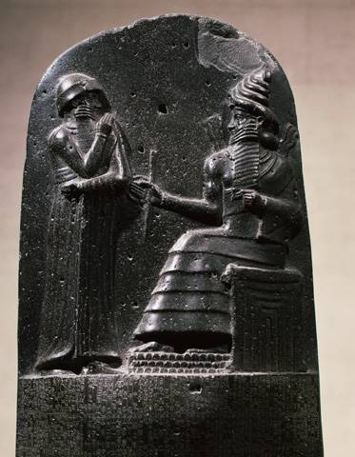
Hammurabi, the Judge

Slide 6
